Slide 1



The Altruism Project
Created by
Swapan Roy

Slide 2

Mission Statement
Mission Statement
Providing a helping hand to the ones who need it
Providing a helping hand to people in need

Slide 3
Problem Statement
People in every country suffer from Mental Health related issues, which get’s amplified in a pandemic environment. A deliberate effort needs to be made to reach out to people who need help.

Slide 4
Problem Statement
Our World in Data reports, there are around 792 million people with mental disorder around world.
Egypt Today report – 25 % of Egyptians suffer from Mental Health related issues.
Washington Post reports- depression rate is greater than 5 % in Middle East above the world average

Slide 5
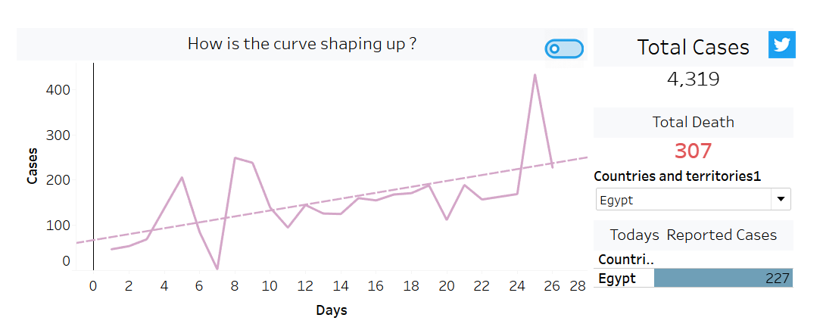
Problem Statement
Covid-19 has made social distancing and distrust a new norm, it will take years for people to completely get over it.
Everyone is fighting the pandemic on their own, we need a community to support
The image on the side shows how Egypt is dealing with it.

Slide 6

The Solution
WhatsApp, G Suite based solution
using community to assist.

Slide 7

Mental Health
Individual
Communication Medium
G Suite is used to collect data & group individuals and gauze progress
The Solution
Community meetings are
set monitored by IEEE, psychiatrist, and
Nurse
Note: WhatsApp and G suite are copyrights of Facebook and Google.

Slide 8
The Details
Individuals volunteer for assistance via a WhatsApp number
In response to the request individuals are invited to fill the “Get to know” form and complete a free Mental health evolution (Free resources can be used, or we can code some using google forms)
Based on the mental health score and education background, individuals are classified into “Individuals”, who need help and “Community Leaders”, who can provide a support system.
Individuals are split into groups of 4-7 people, headed by a community leader.
.
The Solution

Slide 9
The Details
Community leaders are taught to set up call via google meet or zoom and have community building activities. monitored by IEEE, psychiatrist or nurse practitioner from time to time
Every 3 weeks community leaders are expected to inform progress on involvement and Individuals are requested to take a re-test every month.
Using Google sheet, we can gauze progress and chime in when we see an individual is not making enough progress can be refer to a trained nurse or Psychiatric.
The Solution

Slide 10
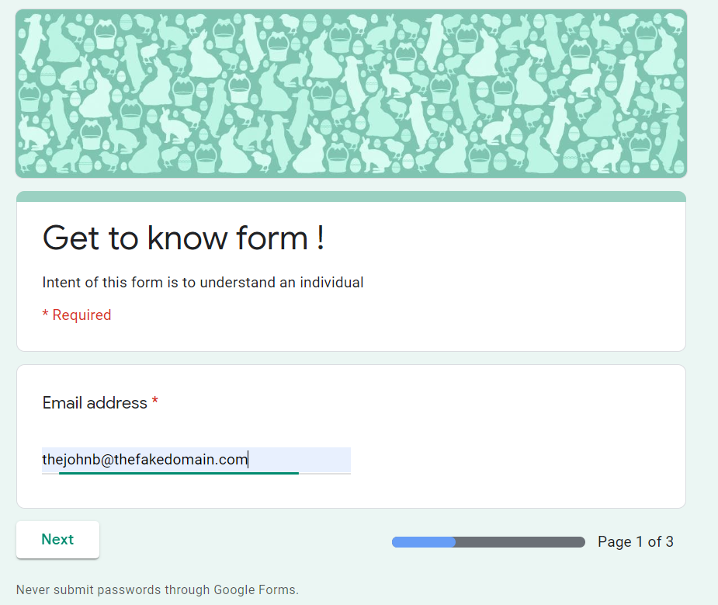

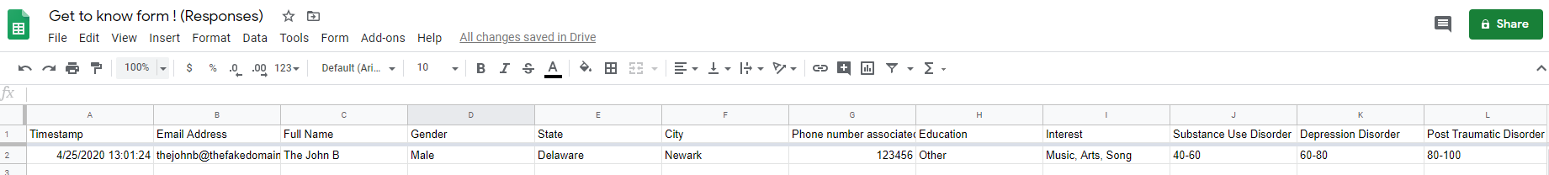
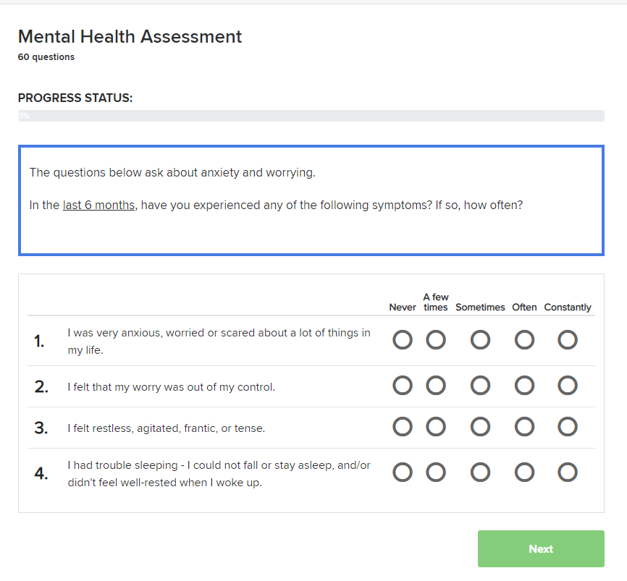

End to End flow
How do we do things.
Google Sheet will assist in pairing people
Re-do the Get to know form and Personality test, so we can gauze the progress
WhatsApp based invite or request to get started
Step 1 |  | Step 2 |  |  | Step 3 |  |  |  | Step 4 |  | Step5
Google meet or similar tools used for meeting
Complete a Get to know form and Personality test

Slide 11
Thanks you !

Slide 12
Resources
https://www.psychologytoday.com/us/tests/health/mental-health-assessment
https://www.ginger.io/app
https://www.egypttoday.com/Article/1/48156/25-of-Egyptians-suffer-from-mental-health-issues-survey
https://www.worldometers.info/world-population/egypt-population/
https://worldpopulationreview.com/
https://psychometer.shezlong.com/en/result/511335 (For psychometric test)
https://ourworldindata.org/mental-health
https://www.al-monitor.com/pulse/originals/2016/12/egypt-online-startup-fight-depression-shezlong.html
https://www.shezlong.com/ (Online help for a fee)

